Slide 1
DATA ENGINEERING CAPSTONE PROJECT TECH CATALYST PROGRAM
Kaitlyn Borski, Benjamin Combs, Isabella Recine, Aryan Zodge
Group 4
August 9, 2024
Notes:
Good morning everyone, my name is Kaitlyn and today my group and I will be presenting our data engineering capstone project for the tech catalyst program here at the Hartford.

Slide 2




Introductions
Kaitlyn
Bentley University
Computer Information Systems
Aryan
University of Utah
Information Systems
Ben
Central Connecticut State University
Computer Science
Bella
Bryant University
Data Science
Notes:
Before we get into the project we wanted to go through some quick introductions of the members of our group. As I just mentioned my name is Kaitlyn and I studied computer information systems at Bentley university for my undergraduate degree
1.Kaitlyn
2.Ben
3.Aryan
4.Bella

Slide 3

Current Problems and Goals
Limited understanding of customer demand
Regional demand
Accident patterns
Cost of accidents
Improve safety and efficiency by analyzing taxi demand locations and accident hotspots
All goals must be reached in 5 business days
Notes:
Ben
To get a better understanding of where we began we wanted to achieve

Slide 4
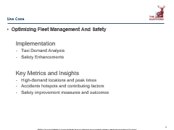
Use Case
Optimizing Fleet Management And Safety
Implementation
Taxi Demand Analysis
Safety Enhancements
Key Metrics and Insights
High-demand locations and peak times
Accidents hotspots and contributing factors
Safety improvement measures and outcomes
Notes:
Aryan

Slide 5
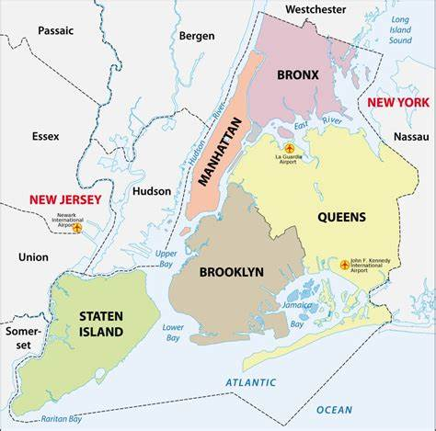
The Data
High Volume For-Hire Vehicle (HVFHV) Data
Trip data from high-volume for-hire vehicle bases like Uber and Lyft, community livery bases, luxury limousine bases, and black car bases
Yellow and Green Taxi Data
Yellow and Green taxis can be street hailed or through an e-hail app
Motor Vehicle Collisions Data (External Data)
Contains all police reported motor vehicle collisions in NYC
Reports are required to be filed for collisions where someone is injured or killed, or where there is at least $1,000 worth of damage
~ 100 million rows
Jan. 2024 – May 2024
~ 34 million rows
Sept. 2023 – May 2024
~ 488 thousand rows
Jan. 2019 – Aug. 2024
Notes:
Now I will go into the data we used. For this project, we used the three main sources of data, plus one external data source. It should be noted that all data sources only look at data from new York city
The first dataset we worked with was the high volume for hire vehicle data, which consists of a little over 100 million rows for the data that ranges from January to may 2024, which is what we had analyzed. The high volume for hire data consists of trips from for hire vehicle bases like uber and lyft as well as community livery bases, luxury limousine bases, and black car bases.
Next we worked with the yellow and green taxi data, which were originally stored in separate parquet files but we were able to merge the data into a single dataframe made up of approximately 34 million rows with the data ranging from September 2023 to may 2024. yellow and green taxis are vehicles that can either be street hailed by signaling to a driver who is on duty and seeking a passenger or hailed through an ehail app
Lastly, for our external data source we looked at motor vehicle collisions data over the last five years which resulted in about 488 thousand rows of data. It should be noted that this dataset does not include every instance of vehicle collisions in new York city, only those collisions where someone was unfortunately injured or killed or where the accident resulted in at least 1,000 dollars of damage

Slide 6
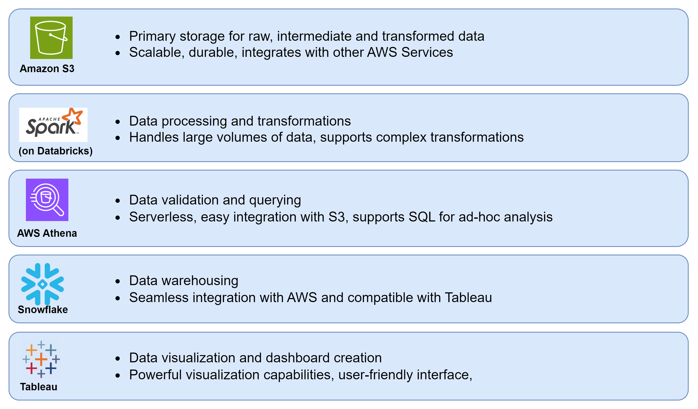
Technologies

Slide 7
Architecture Diagram
Notes:
Aryan

Slide 8
Data Exploration and Transformations
27%
191,126 rows
saved
1.8%
12,467 rows
saved
6.2%
42,805 rows
lost
Assumptions
Null passenger count is equal to one passenger
Null congestion surcharge and airport fees are equal to $0.00
Null Accident Cause and Null Vehicle Type is ‘Unspecified’
Transformations
Merge Yellow and Green taxi datasets
Filter to desired date ranges (5 years historical accident data)
Classify whether an injury or fatality occurred
Determine missing borough based on geographic coordinates
Notes:
Ben
Accident Data Set was very large and had records from 2002. We chose to trim it down to 5 years because we could still pull meaningful accurate stats while reducing the ETL process time.
Saved approx : 12.5 thousand rows by using borough column to fill missing longitude and latitude columns
Borough Column important for joining data for visualization and analysis
Saved approx : 191,000 rows by using longitude and latitude to fill missing borough, about 27% of the total rows
Discovered anomalous raw data in the form of incorrect borough classification.

Slide 9
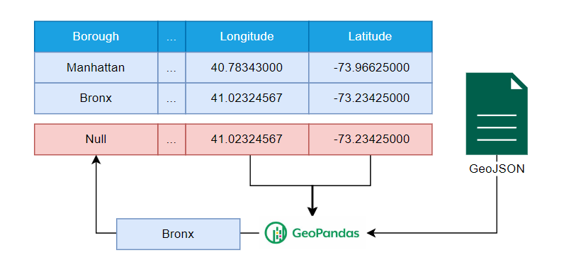
Data Exploration Visualization
Notes:
Ben
Diagram showing how GeoData of NYC Boroughs is used to fill NULL values

Slide 10
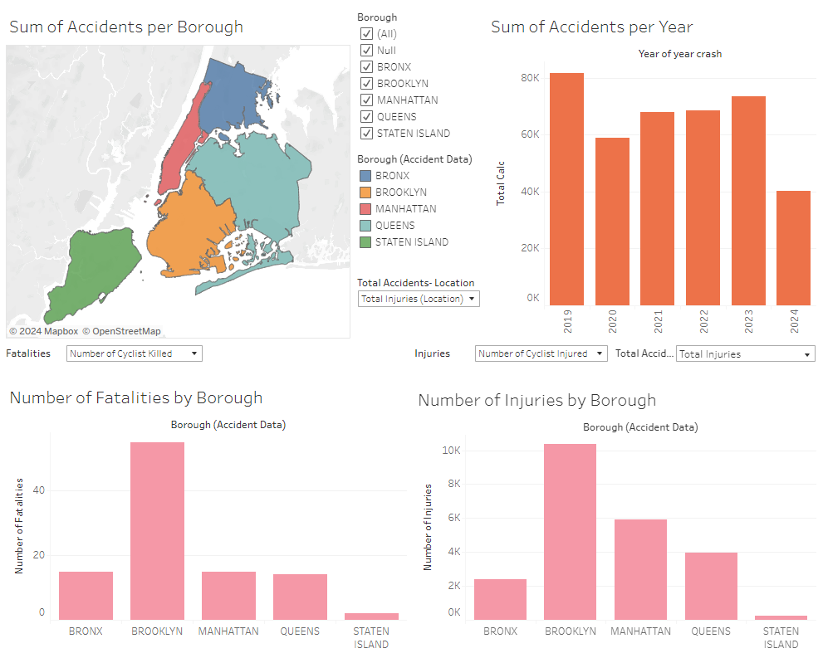
Data Visualization- Accidents Dashboard
Notes:
Bella

Slide 11
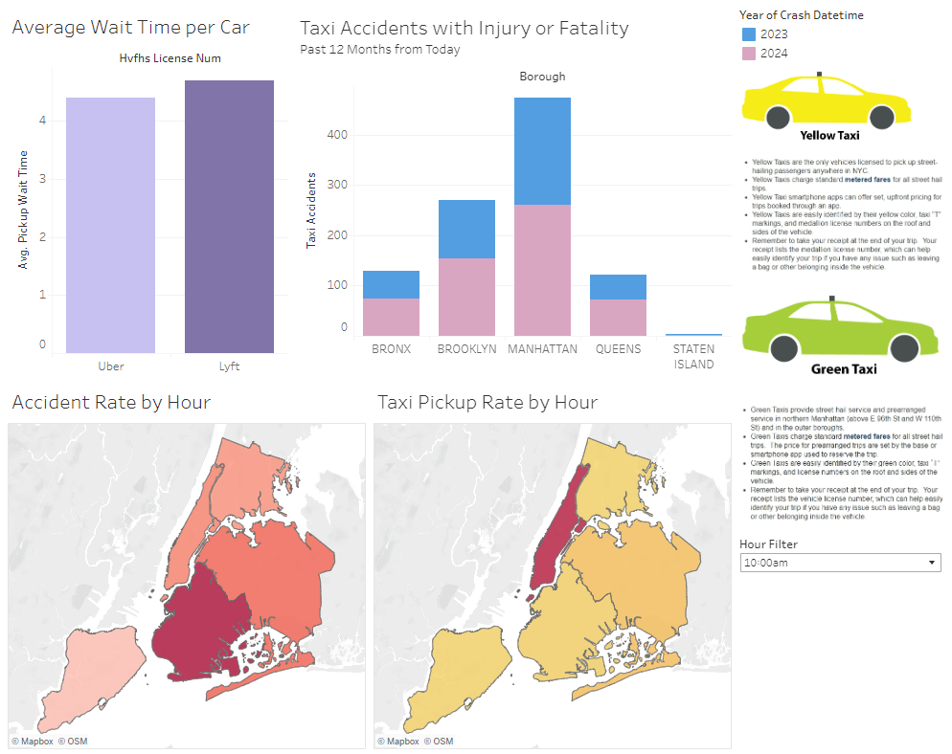
Data Visualization- Taxi Dashboard
Notes:
Bella

Slide 12
Challenges & Limitations
The volume of the HVFHV data caused the kernel to crash when doing transformations
Long wait times for data transformations
Data isn’t always accurate
Accident data doesn’t include all collision instances
Tableau implementation for data visualizations
Notes:
Now I am going to go into detail of some of the challenges and limitations we faced while working on this project.
As I had mentioned at the beginning of the presentation, the high volume for hire vehicle data contained over 100 million rows of data, even after we performed data cleaning. This immense volume of data caused the kernel in databricks to crash when trying to perform transformations to the data and uploading the adjusted data as partitioned files in the s3 buckets.
Since the data was so large, this also resulted in wait times up to an hour when running blocks of code in databricks and snowflake. This was very inconvenient and resulted in long periods of down time, causing bottlenecks in the project
Next, as you have seen in the tableau dashboards, there were a few anomalies in the data, showing that some collisions had mislabeled borough names. This was an anomaly in the original dataset and we contemplated dropping these rows but ultimately chose to keep them and make note of them here.
Additionally, as I had noted in one of the earlier slides, the accident dataset doesn’t include all collision instances, proving to be a limitation in our analyses.
We also faced issues when creating the dashboards in tableau. For the Accidents dashboard the data was so large it kept crashing tableau. Additionally the shape file for the map wouldn’t connect with the accident data, making it difficult to visualize the accidents on a map

Slide 13
Future State & Recommendations
With More Time and Money We Can Accomplish Anything!
Connect to NYC API
Predictive Modeling
Prescriptive Analysis
NYC API Connection
[2 – 4 Weeks]
Predictive Modeling
[8 Months – 1 Year]
Prescriptive Analysis
[4 – 6 Months]
Schedule batch load of new Taxi and Accident daily.
Implement more data quality checks
Develop a predictive model to forecast taxi demand and accidents.
AWS Sagemaker
Develop variable pricing model to increase revenue.
Notes:
Propose a Future State plan for the next phase, suggesting further enhancements beyond this MVP. Outline what can be done, how it can be achieved, and provide a diagram with estimated timelines and effort required
More data quality checks to account for anomalous raw data (such as borough in accident data as shown previously)
Ben

Slide 14
Thank You! Want to learn more?
Click here to check out our GitHub.
Notes:
We wanted to thank Tarek and Harshit for an amazing and memorable 8 weeks of training. And to thank all

Slide 15
Any Questions?

